Slide 1
AI Health Symptom Checker
IBM HACKATHON PROJECT
Presented By: Sajid Khan
Student name : Mohd Sajid Khan
College Name & Department : Ashoka Institute of Technology (Computer Science & Engineering)

Slide 2
OUTLINE
Problem Statement
Technology used
Wow factor
End users
Result
Conclusion
Git-hub Link
Future scope
IBM Certifications

Slide 3
Problem Statement
Agentic AI Health Symptom Checker– An Agentic AI Health Symptom Checker helps users understand their health conditions by analyzing symptoms and providing probable causes, preventive advice, and care recommendations. It retrieves verified medical data, symptom databases, and guidelines from trusted sources like WHO, government health portals, and medical journals.
Proposed Solution: An AI Research Agent that uses Natural Language Processing (NLP), Retrieval-Augmented Generation (RAG), Users can input symptoms in natural language such as “I have a sore throat and fever,” and the agent provides possible conditions, urgency level, home remedies, and when to consult a doctor. It supports multi-language interaction and avoids self-diagnosis risks by offering educational and referral-based suggestions.

Slide 4
Technology used
IBM cloud lite services
Natural Language Processing (NLP)
Retrieval Augmented Generation (RAG)
IBM Granite model

Slide 5
IBM cloud services used
IBM Cloud Watsonx AI Studio
IBM Cloud Watsonx AI runtime
IBM Cloud Agent Lab
IBM Granite foundation model

Slide 6
Wow factors
Natural Language Interaction Users describe symptoms conversationally – no need for medical jargon.
Multi-Language Support Understands and responds in multiple languages to serve a broader audience.
Trusted Medical Sources Backed by verified data from WHO, government health portals, and medical journals.
Risk-Free Health Education Provides guidance without diagnosing – reducing misinformation and panic.
Personalized Remedies Suggests home remedies and preventive care based on user symptoms.
Urgency Detection Assesses severity and guides users: rest, consult, or emergency action.
Early Health Awareness Promotes timely self-checks and early detection to avoid critical conditions.

Slide 7
End users
General Public
Rural and Remote Population
Student and Young Adults
Educators

Slide 8
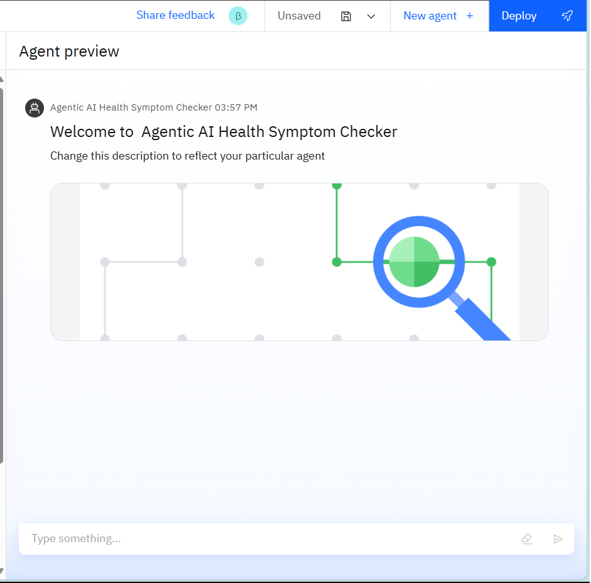
Results

Slide 9
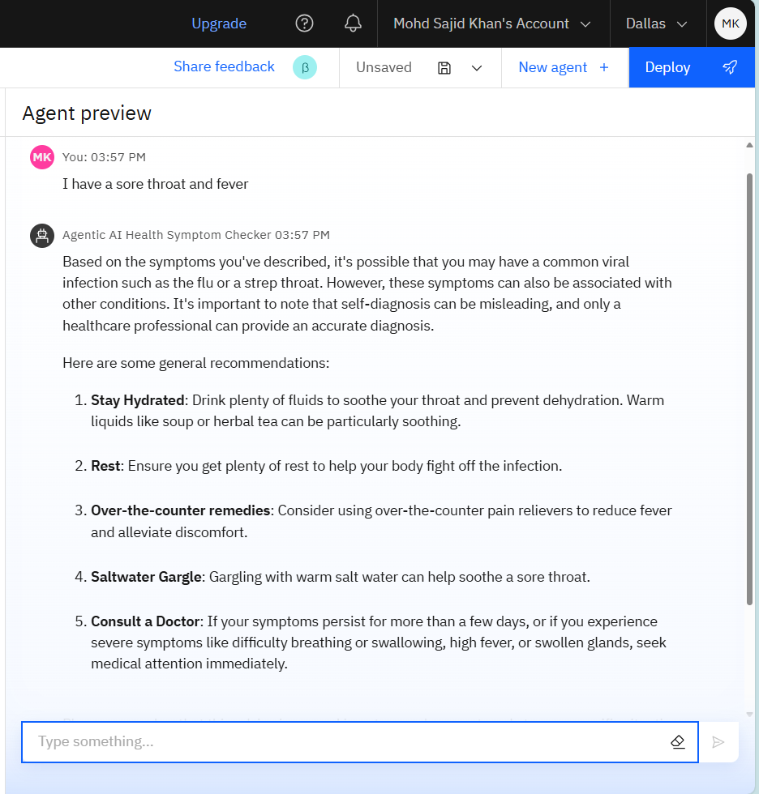
Results

Slide 10
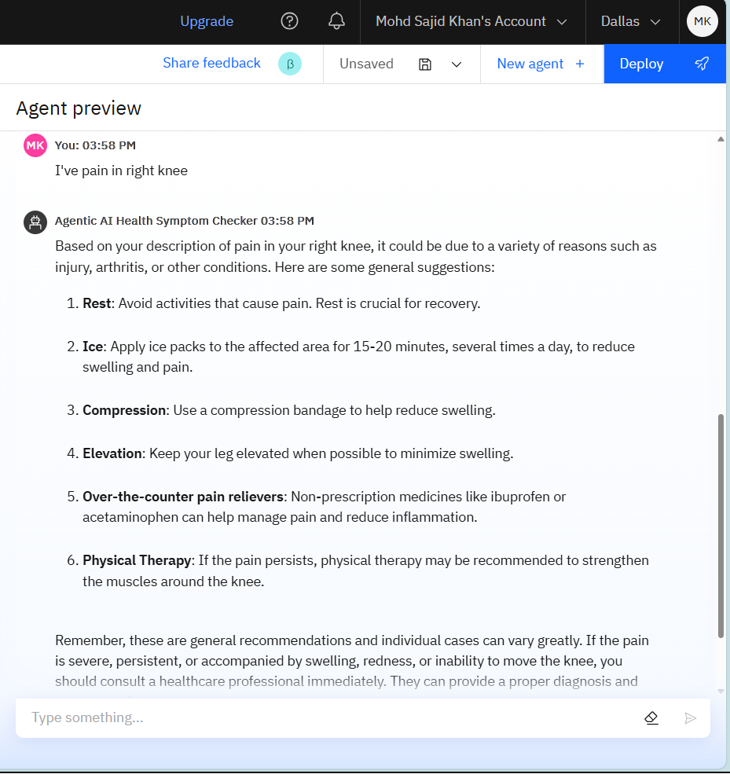
Results

Slide 11
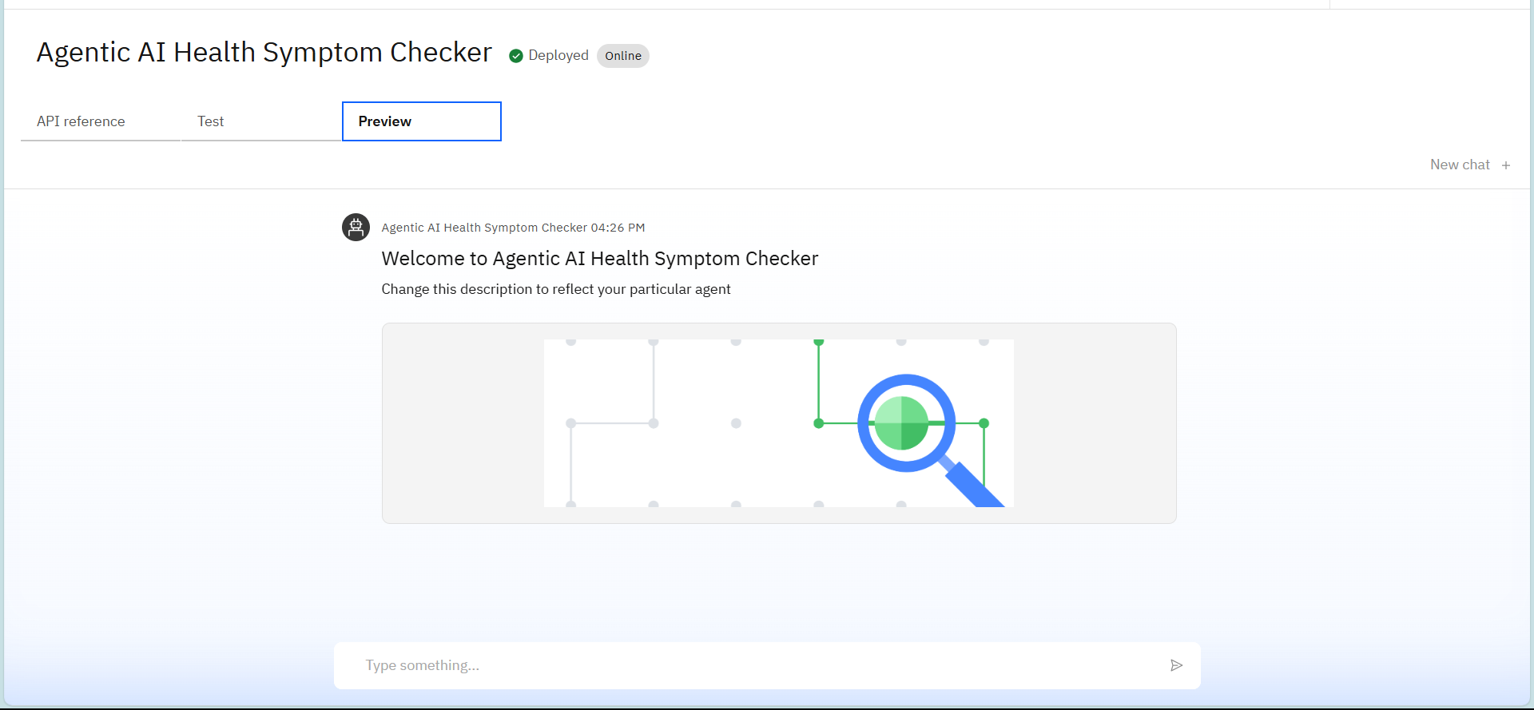
Results
Deployed AI Agent

Slide 12
Conclusion
The agent promotes early detection.
Bridges healthcare gaps, especially in underserved communities.
Ensures a safe, inclusive, and user-friendly experience

Slide 13
GitHub Link
sajidkhnx/Health-Checker-AI-Agent-IBM-Intern-Project

Slide 14
Future scope
Real-Time Doctor Integration Enable live chat or appointment booking with certified doctors based on symptom severity.
Geo-Based Health Services Recommend nearby clinics, pharmacies, or testing centers using location data.
Health Trends & Predictive Analytics Aggregate anonymous user data to detect regional health trends, outbreaks, and seasonal illnesses.
Voice and Visual Symptom Input Allow users to speak symptoms or upload images (e.g., rashes, swelling) for advanced analysis.
Integration with Wearables and IoT Devices Connect with fitness trackers or smart health devices to provide proactive care suggestions.

Slide 15
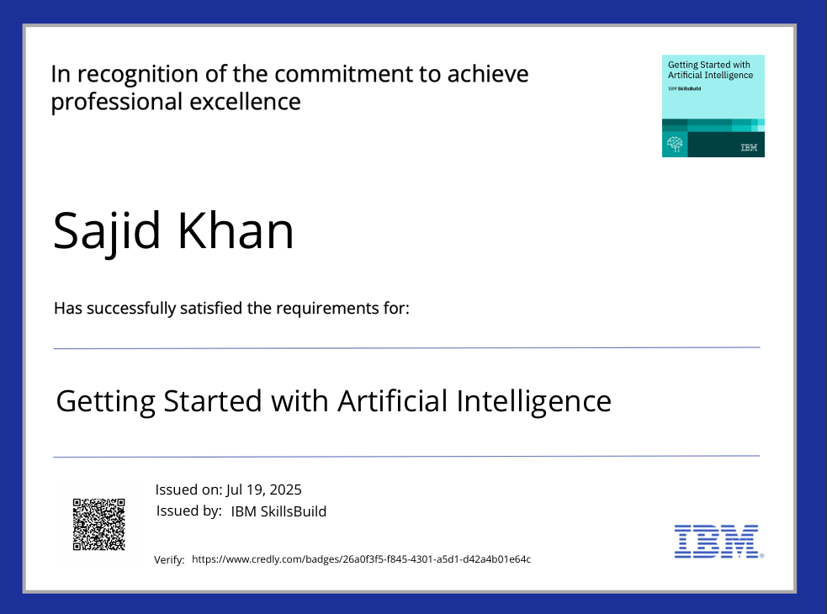
IBM Certifications
Screenshot/ credly certificate( getting started with AI)

Slide 16
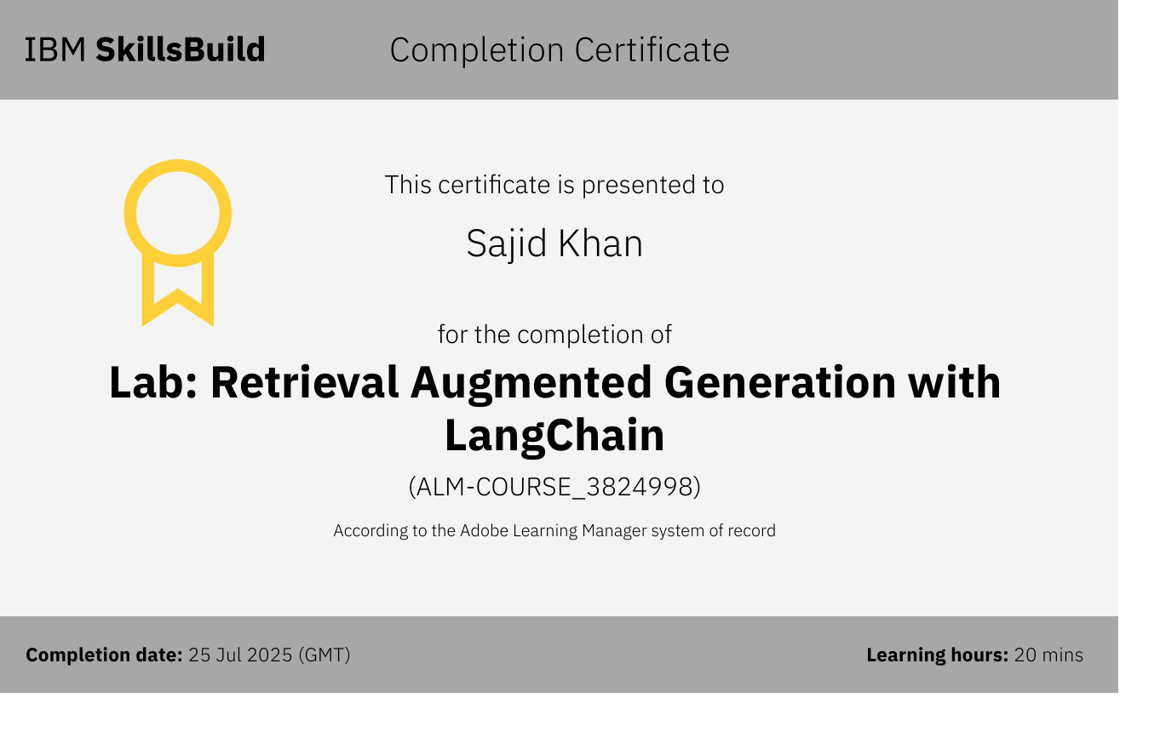
Attach your RAG LAB certificate here

Slide 17
THANK YOU

